Slide 1
FILE MANAGEMENT SYSTEM
Having Systemadmin,Admin and user

Slide 2
CREATORS
MUHAMMAD AFZAL HASHMI
MUHAMMAD HAMID NADEEM
MUHAMMAD YOUSAF
F2021266252
F2021266271
F2021266253

Slide 3
INTERFACES
01
02
SYSTEM ADMIN
ADMIN
03
USER
Have access to system Details 14 funcationalities
Advance File Management 16 funcationalities
Basic File Management 7 functionalities

Slide 4
OUR CODE Our Code is Divided into Two Parts
Menu Code:
Main Code:
Menu code will be written in C & C++ programming language.
This will provide the basic menu (options) to select which operation we want to perform.
In this part of the code, we will use Bash scripting to implement the operations the user selects.
We utilize a while loop to repeatedly display and compile the menu code. Based on the user's preference, execute the corresponding file operation.

Slide 5
CODE
CODE AND PLATFORMS
PLATFORMS
Languages that will be used to develop this project:
Bash Scripting (.sh extension) Basic functionality
C language (.c extension) User menu
C++ language (.cpp extension) Admin menu
C++ language (.cpp extension) System Admin menu
Developed in the Ubuntu Subsystem
Linux
VMWare

Slide 6
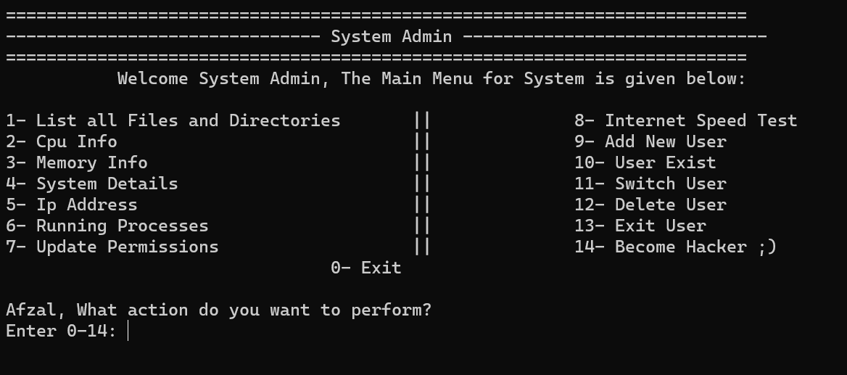
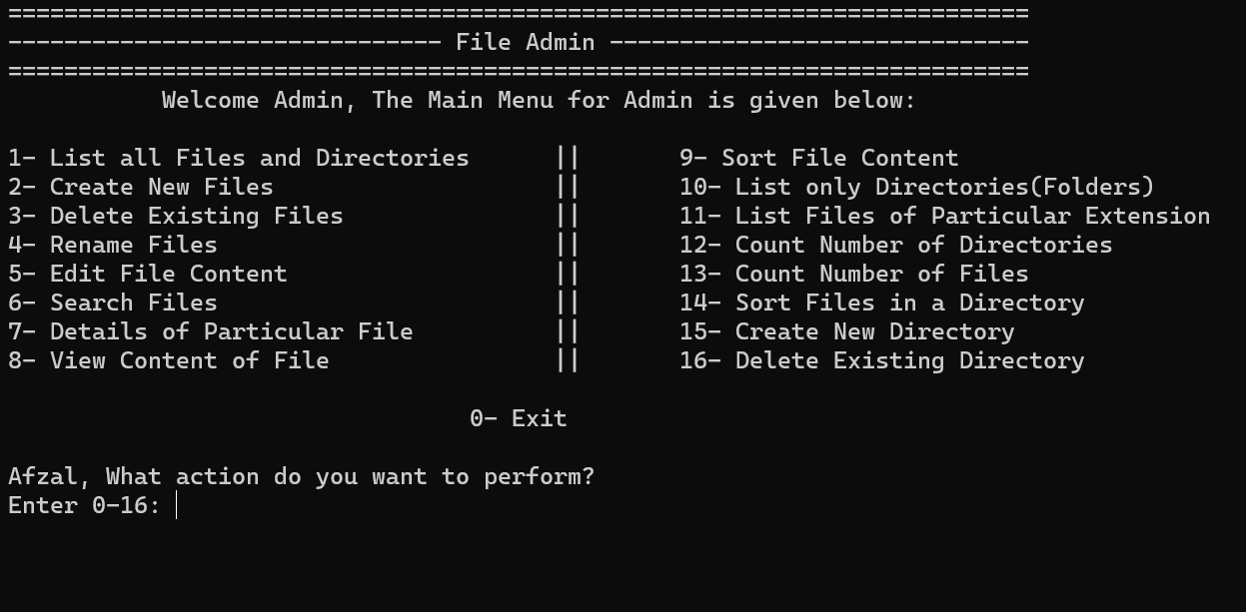
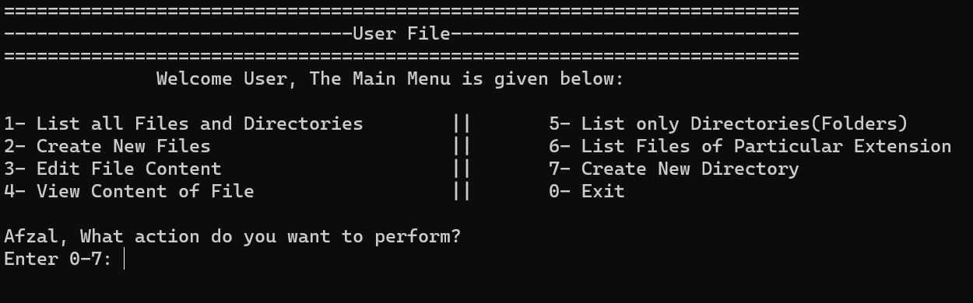
FUNCATIONALITIES
SYSTEM ADMIN
ADMIN
USER

Slide 7
FUNCATIONALITIES
SYSTEM ADMIN
ADMIN
USER

Slide 8
FUNCATIONALITIES
SYSTEM ADMIN
ADMIN
USER

Slide 9
FUNCATIONALITIES
SYSTEM ADMIN
ADMIN
USER

Slide 10
FUNCATIONALITIES
SYSTEM ADMIN
ADMIN
USER

Slide 11
FUNCATIONALITIES
SYSTEM ADMIN
ADMIN
USER

Slide 12
FUNCATIONALITIES
SYSTEM ADMIN
ADMIN
USER

Slide 13
CONCLUSIONS
Achievements: Successful implementation of fundamental file management functionalities using C, C++, and Bash Scripting.
Teamwork: Working together to complete this project shows teamwork.

Slide 14

THANK YOU
https://github.com/Afzal-Hashmi/OS-Lab-Project

